Slide 1








Linear Algebra
MAT291
Notes:
Name: Md. Riyad Ahmed Hridoy
ID:2024-3-27-044
Couse Name: Linear Algebra (MAT291)

Slide 2


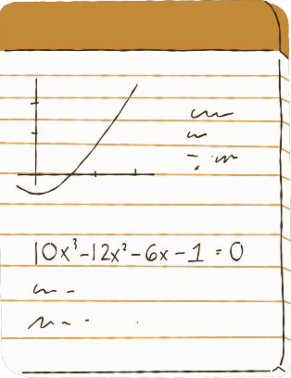

Introduction
Name : Md Riyad Ahmed Hridoy
ID : 2024-3-27-044
Student No : 30
Course Instructor : Dr. A. K. M. Nazimuddin

Slide 3




Topic Title: LU Method
What is LU Decomposition?
[N x N] Lower Triangular Matrix
[N x N]
[N x N] Upper Triangular Matrix

Slide 4


How Does LU Decomposition Work?
A square matrix A is decomposed into L × U

Slide 5







Question 2
Simplify the expression:

Slide 6

Answer
Simplify the expression:

Slide 7






Question 3
Simplify the expression:

Slide 8
Answer:
Simplify the expression:

Slide 9



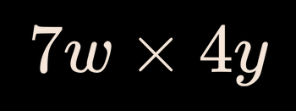

Question 4
Simplify the expression:

Slide 10
Answer:
Simplify the expression:

Slide 11

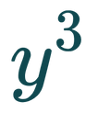

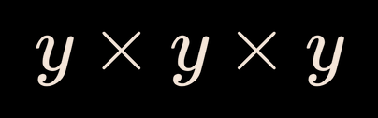

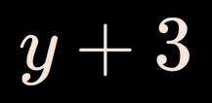
Question 5
Simplify the expression:

Slide 12
Answer:
Simplify the expression:

Slide 13

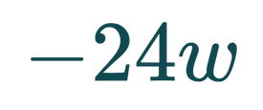
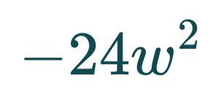
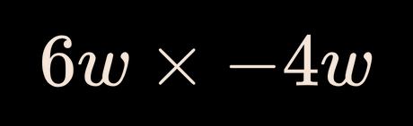

Question 6
Simplify the expression:

Slide 14
Answer:
Simplify the expression:

Slide 15

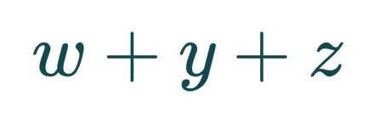



Question 7
Simplify the expression:

Slide 16
Answer:
Simplify the expression:

Slide 17


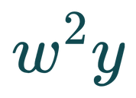


Question 8
Simplify the expression:

Slide 18
Answer:
Simplify the expression:

Slide 19


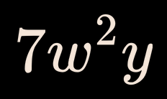

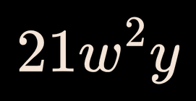
Question 9
Simplify the expression:

Slide 20
Answer:
Simplify the expression:

Slide 21

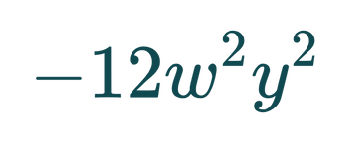
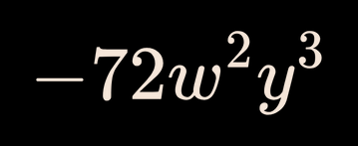
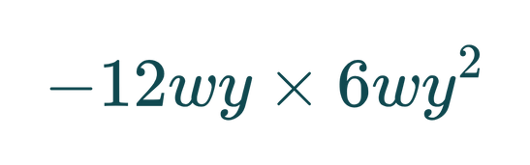

Question 10
Simplify the expression:

Slide 22
Answer:
Simplify the expression:

Slide 23






Instructions
Thank You EveryOne!
This quiz consists of 10 multiple-choice questions. Write your answers on your mini-whiteboard and raise it when your teacher instructs you to do so.

